Slide 1
DAFFODILS
By
William Wordsworth

Slide 2
I Degree General English
Poetry
Prepared by
V. Lydia Vedam,
M.A., M.Ed. Lecturer in English,
JMJ College For Women, Tenali.

Slide 3
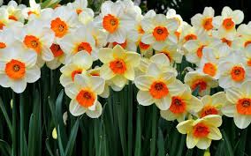
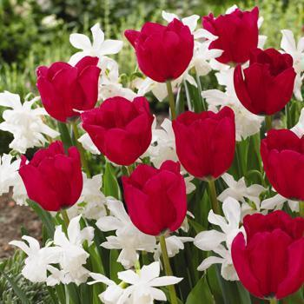
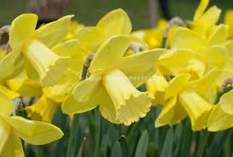

Slide 4
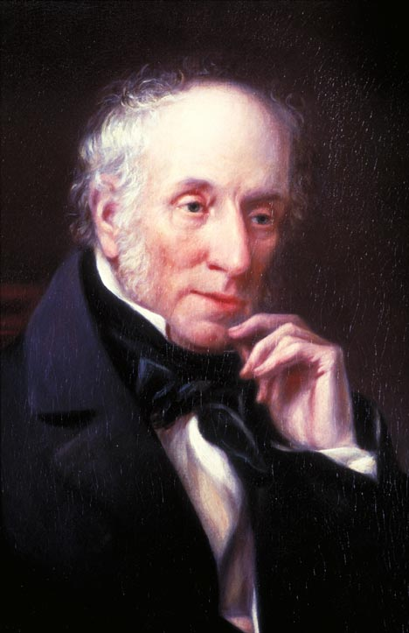

Slide 5
About Wordsworth
Wordsworth stands supreme as a nature poet. Born at Cockermouth(England) in the year 1770, he spent his childhood amidst nature. He was sent to St. John’s College, Cambridge, 1787. After his return from France he stayed with his sister and Coleridge. He got married in 1802.

Slide 6
I wandered lonely as a cloud
That floats on high o'er vales and hills,
When all at once I saw a crowd,
A host, of golden daffodils;
Beside the lake, beneath the trees,
Fluttering and dancing in the breeze.

Slide 7
Continuous as the stars that shine
And twinkle on the milky way,
They stretched in never-ending line
Along the margin of a bay:
Ten thousand saw I at a glance,
Tossing their heads in sprightly dance.

Slide 8
The waves beside them danced; but they
Outdid the sparkling waves in glee:
A poet could not but be gay,
In such a jocund company:
I gazed—and gazed—but little thought
What wealth the show to me had brought:

Slide 9
For oft, when on my couch I lie
In vacant or in pensive mood,
They flash upon that inward eye
Which is the bliss of solitude;
And then my heart with pleasure fills,
And dances with the daffodils.

Slide 10
Mood of the Poem Daffodils:
The poem goes through a gradual shift..from wandered lonely and pleasures fill. This in actual reflects Wordsworth’s life. The feeling of loneliness was marked by the death of his brother John. Dorothy had been a great sister to Wordsworth and also Wordsworth got married in the same year 1802 (his second marriage). These life events were actually responsible for Wordsworth’s actually happiness in his life and thus correlates with Daffodils.

Slide 11
The poem was written in the year 1802. It was first published in Poems in Two Volumes, in 1807. The very starting line of the poem “I wandered lonely as a cloud” informs the poets profound sentiments of being left alone. It was actually the death of his brother John that led him to “loneliness”. We should remind the readers that this poem was not a result of imagination. Dorothy, Wordsworth’s sister provides us an explanation of the occasion which inspired Wordsworth to produce this masterpiece:–
“When we were in the woods beyond Gowbarrow park, we saw a few daffodils close to waterside.” Thus the poem is a result of actual visualization rather than imagery”.

Slide 12
William Wordsworth was an avid(passionate) observer of nature. In this poem, he describes the impression a cluster of daffodil flowers created in his mind when he saw them while taking a stroll beside a lake hemmed(surrounded) by some trees.

Slide 13
STANZA 1 ..
The beauty of the daffodils lifted his mind and his spirit. His imagination and his poetic instincts came to the fore(nearest). He could see himself as a cloud floating past the golden-coloured daffodils on the ground where some trees stood beside a lake. The flowers were swaying(swinging) in the breeze. This gentle movement enhanced their attraction.

Slide 14
STANZA 2..
The daffodils were numerous in number. They seemed to stretch in an endless line. The poet felt as if they were like the twinkling stars in the Milky Way. Clearly, the poet has been profoundly enchanted(delighted) by the daffodils’ beauty, accentuated(highlighted) by their alternating swaying movements. The flowers, appearing full of life and beauty, have un-fettered (loosen) the poetic imagination of Wordsworth.

Slide 15
STANZA 3..
The waves in the lake swayed too, pushed by the breeze. But the beauty of the daffodils was far more enchanting than that of the waves. The poet could not take his eyes off the golden daffodils. He remained enthralled (fascinated) by their beauty. He began to wonder what a great bounty of nature he had stumbled (fascinated) upon.

Slide 16
STANZA 4..
This pleasant encounter with the daffodils by the lake remained dormant (passive) in the poet’s sub-conscious mind. When he was lonely or his spirits were low, the memory of his encounter with the daffodils would surface, plunging his mind with immense pleasure. Thus, the scene remained as a priceless treasure and an in-exhaustible (endless) source of joy for the poet.

Slide 17


